Slide 1
Introduction to .NET Core Platform and Visual Studio.NET

Slide 2
Objectives
Overview .NET Framework Architecture
Overview .NET Core and .NET
Introduction to Cross-platform application with .NET
Explain why .NET Core and C# Language is selected as develop application?
Explain meaning "dotnet CLI”
Explain about NuGet package
Demo create and run C# Console Application on Windows, Mac and Linux using “dotnet CLI”

Slide 3
.NET Framework and .NET

Slide 4
The History of .NET Framework and .NET Core
.NET Framework: Introduced in 2002, .NET Framework was Microsoft's primary platform for building and running Windows applications. It provided a comprehensive framework for developing various types of applications including desktop, web, and server applications. .NET Framework was tightly coupled with Windows and tied to the Windows operating system.
.NET Core Announcement: In 2014, Microsoft announced .NET Core, a modular, open-source, cross-platform version of the .NET Framework. This was a significant departure from the Windows-only focus of the .NET Framework. .NET Core was designed to be lightweight, modular, and able to run on different operating systems, including Windows, macOS, and Linux.

Slide 5
The History of .NET Framework and .NET Core
Initial Releases of .NET Core (2016): The first preview release of .NET Core was in 2016. It included a subset of the full .NET Framework functionality but with cross-platform support. Initially, it was targeted mainly for building web applications and services.
.NET Core Becomes .NET 5 (2020): Microsoft announced that .NET Core 3.0 would be the last release under the ".NET Core" name. Starting with version 3.0, it would simply be called ".NET." Alongside this change, Microsoft announced a new versioning scheme, with the next release being ".NET 5." The decision to skip versions 4.x was to align the platform versions across .NET Framework and .NET Core.

Slide 6
The History of .NET Framework and .NET Core
Unified Platform with .NET 5 and Beyond: .NET 5, released in November 2020, marked a significant milestone in the unification of the .NET platform. It merged the capabilities of .NET Core, .NET Framework, and Xamarin (which was used for building mobile applications) into a single platform. This consolidation aimed to simplify development and provide a consistent experience across different types of applications.
.NET 6 and Beyond: .NET 6, released in November 2021, continued the trend of enhancing performance, improving developer productivity, and expanding support for more workloads and platforms. Microsoft's roadmap includes further improvements in areas such as cloud-native development, IoT, AI, and machine learning.
.NET

Slide 7
The History of .NET Framework and .NET Core
.NET 8 (Nov 2023) allows developers to build a wide range of applications, including Windows, web, mobile, and console ones.
Typically, each new version of .NET brings enhancements in performance, features, and tooling to improve the development experience and support a wider range of application scenarios. If .NET 8 has been released, you can expect it to continue this trend of innovation and improvement within the .NET ecosystem.

Slide 8
Introducing .NET Core
Open-Source: Open-source framework, meaning its source code is freely available and can be modified and distributed by anyone.
Cross-Platform: Emphasize that .NET Core is designed to run on various operating systems, including Windows, macOS, and Linux.
Modular Framework: Describe the modular nature of .NET Core, where functionalities are divided into individual NuGet packages.
Performance and Scalability: Highlight the performance benefits of .NET Core, such as its efficient runtime and optimized libraries.

Slide 9
.NET 8: Enhanced Performance and Productivity
Native AOT Compilation: Introduce Native AOT as a new deployment option for creating self-contained applications with faster startup times and smaller memory footprints.
Container Improvements: Discuss enhancements for containerized applications, such as improved image size and startup time optimizations.
Performance Enhancements: Briefly mention various performance improvements across the framework, including optimizations in core libraries and runtime.
Observability and Diagnostics: Introduce new tools and APIs for monitoring and diagnosing .NET applications, allowing for better insights into application behavior and troubleshooting.

Slide 10
.NET 8: Modern Language Features and APIs
C# 12 Enhancements: Briefly showcase new language features introduced in C# 12, such as primary constructors for non-record types, aliasing any type, and improved interop capabilities.
.NET Libraries Updates: Highlight updates to key .NET libraries.
Blazor Unification: Introduce the new unified Blazor hosting model, allowing developers to choose between different rendering modes (server-side, WebAssembly, or hybrid) on a per-component basis, enhancing flexibility and performance.
Minimal APIs Advancements: Discuss new capabilities in Minimal APIs for building lightweight and efficient web services, including improved route tooling and support for streaming scenarios.

Slide 11
.NET Core Architecture
.NET CLI: Introduce the dotnet command-line interface as the primary tool for managing .NET Core projects and applications. Explain its role in tasks like project creation, building, running, and publishing applications.
.NET Runtime: Explain the role of the .NET runtime environment (CoreCLR) for executing .NET Core applications. Discuss features like just-in-time (JIT) compilation and garbage collection.
Base Class Library (BCL): Describe the BCL as a collection of essential libraries providing fundamental functionalities like file I/O, networking, collections, and more.
ASP.NET Core: Briefly introduce ASP.NET Core as a framework for building web applications and services on top of .NET Core. Mention key components like MVC, Razor Pages, and Blazor.

Slide 12
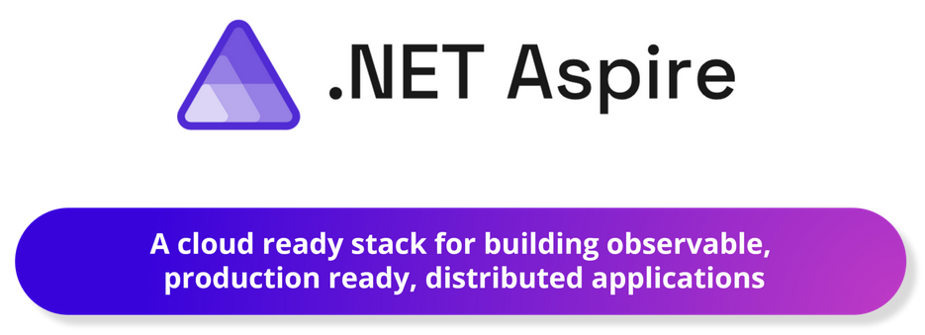
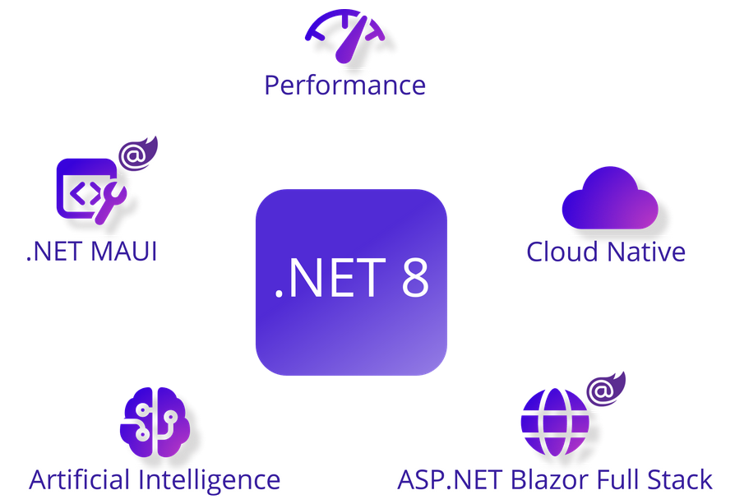
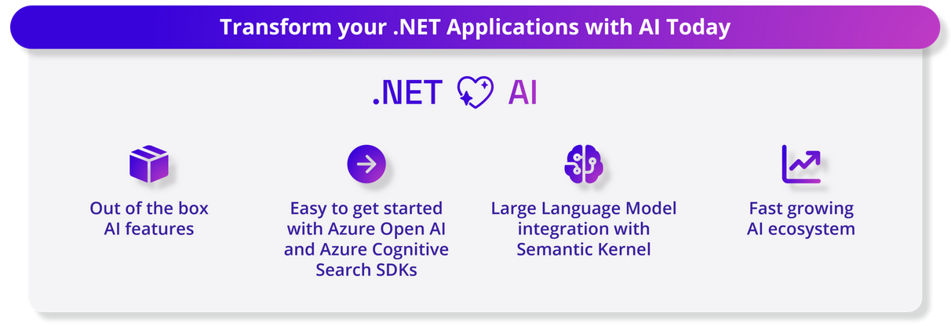
.NET 8
Notes:
https://devblogs.microsoft.com/dotnet/announcing-dotnet-8/

Slide 13
Core Common Language Runtime(CoreCLR)
A common runtime for all .NET languages
Common type system
Common metadata
Intermediate Language (IL) to native code compilers
Memory allocation and garbage collection
Code execution and security
Over 15 languages supported today
C#, VB, Jscript, Visual C++ from Microsoft
Perl, Python, Smalltalk, Cobol, Haskell, Mercury, Eiffel, Oberon, Oz, Pascal, APL, CAML, Scheme, etc.

Slide 14
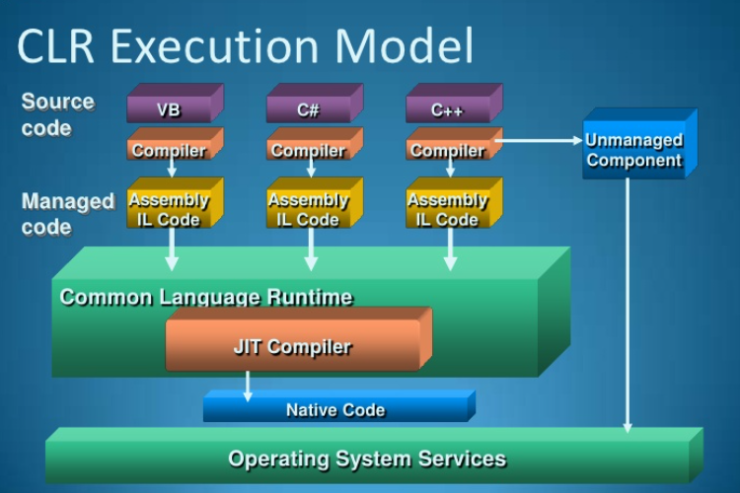
Common Language Runtime (CLR)

Slide 15
Advantages of Core CLR
Interoperation between managed code and unmanaged code (COM, DLLs)
Managed code environment
Improved memory handling
JIT (Just-In-Time) Compiler allows code to run in a protected environment as managed code
JIT allows the IL code to be hardware independent
CLR also allows for enforcement of code access security
Verification of type safety
Access to Metadata (enhanced Type Information)

Slide 16
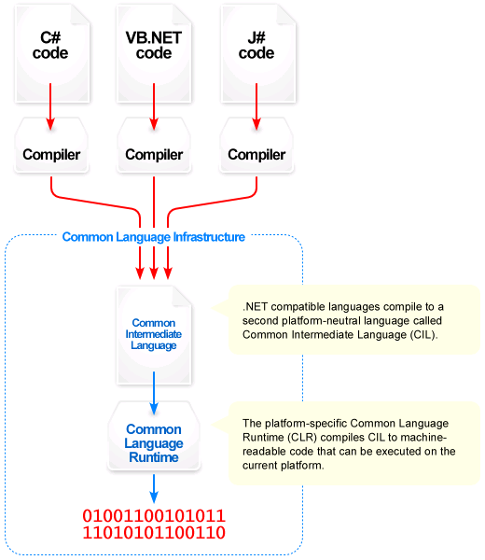
Common Language Infrastructure

Slide 17
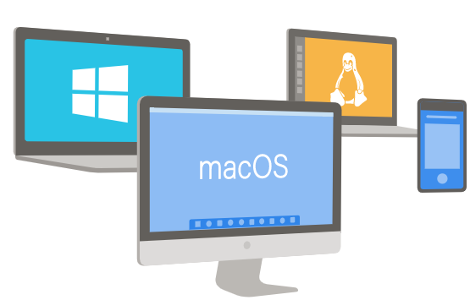
Cross-Platform Application
“Write once, run anywhere” seems to be the mantra that finds favor with application developers nowadays. This reduces the need for developers to write a lot of redundant code. .NET, an open source offering from Microsoft, is just the tool for writing code for a cross-platform application that will work on Windows, Linux and macOS systems.

Slide 18
Cross-Platform Application
A platform is a computer hardware and software combination on which a program runs. A platform is a combination of both hardware resources: CPU frequency, RAM size, HDD space, GPU capacity,…and also the software platform being provided to install on such as Operating system; Third-party or extended framework(.NET or JVM,..)
Cross-platform support runs on multiple platforms. In a sense, it means that a code can run on multiple frameworks, platforms, operating systems, and machine architectures.
A cross-platform programming language is one that can run on multiple frameworks, operating systems, and machine architectures. Many factors cause the language or tool to be able to run on multiple machines and platforms.

Slide 19
What is the .NET Standard?
.NET Standard is a specification that can be used across all .NET implementations. It is used for developing library projects only. This means if we are creating a library in .NET Standard we can use those in .NET Framework and .NET Core.
To create uniformity means to allow usage in all the .NET implementations. .NET Standard has support for Mono platform, Xamarin, Universal Windows Platform, and Unity.

Slide 20
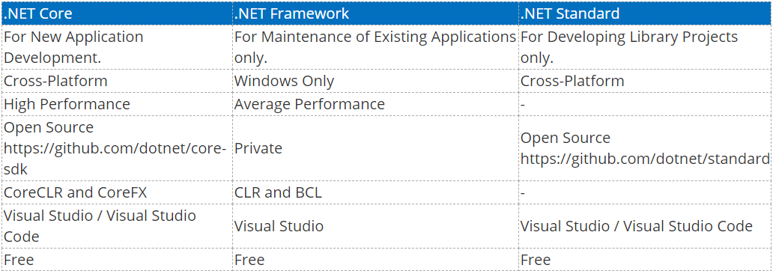
Comparisons Table

Slide 21
New features in .NET 8
Java interoperability will be available on all platforms.
Objective-C and Swift interoperability will be supported on multiple operating systems.
CoreFX will be extended to support static compilation of .NET (ahead-of-time – AOT), smaller footprints and support for more operating systems.

Slide 22
Benefits of using .NET
Open Source: Open source and community-oriented on GitHub.
Cross-Platform: .NET Core can run on Windows, Linux, and macOS
Command-line tools: Create, build, and run projects from the command line
Modular: Ships as NuGet packages
Host Agnostic:
.NET Core on the server side is not dependent on IIS and, with two lightweight servers: Kestrel and WebListener
It can be self-hosted as a Console application and can be also gelled with mature servers such as IIS, Apache, and others through a reverse proxy option
Notes:
.NET Framework 1.0 was released Feb 13, 2002
.NET Core 1.0 was released on June 27, 2016

Slide 23
Benefits of using .NET
Support for leveraging platform-specific capabilities, such as Windows Forms and WPF(Windows Presentation Foundation) on Windows and the native bindings to each native platform from Xamarin.
High performance.
Side-by-side installation.
Small project files (SDK-style).
Visual Studio, Visual Studio for Mac, and Visual Studio Code integration.
Notes:
.NET Framework 1.0 was released Feb 13, 2002
.NET Core 1.0 was released on June 27, 2016

Slide 24
Why C# is selected as develop application?
C# was developed by Anders Hejlsberg and his team during the development of .NET
C# is a modern, object-oriented, and type-safe programming language. C# enables developers to build many types of secure and robust applications that run in the .NET ecosystem. C# has its roots in the C family of languages and will be immediately familiar to C, C++, Java, and JavaScript programmers
C# is designed for Common Language Infrastructure (CLI), which consists of the executable code and runtime environment that allows use of various high-level languages on different computer platforms and architectures

Slide 25
Why C# is selected as develop application?
The following reasons make C# a widely used professional language
It is a modern, general-purpose programming language
It is object oriented.
It is component oriented.
It is easy to learn.
It is a structured language.
It produces efficient programs.
It can be compiled on a variety of computer platforms.
It is a part of .Net
More C# features :
https://docs.microsoft.com/en-us/dotnet/csharp/language-reference/

Slide 26
Introduction to dotnet CLI
Download: https://dotnet.microsoft.com/en-us/download/dotnet
Check SDK versions
dotnet --list-sdks
Check runtime versions
dotnet --list-runtimes
The global.json file allows you to define which .NET SDK version is used when you run .NET CLI commands.
dotnet new globaljson

Slide 27
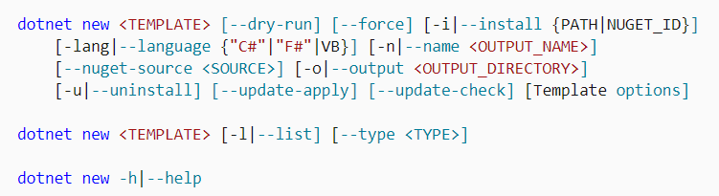
Introduction to dotnet CLI
The .NET command-line interface(CLI) is a cross-platform for developing, building, running, and publishing .NET applications.
More dotnet CLI :
https://docs.microsoft.com/en-us/dotnet/core/tools/dotnet/

Slide 28
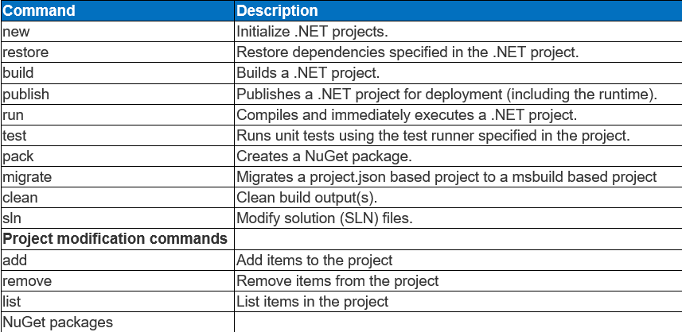
Introduction to dotnet CLI

Slide 29
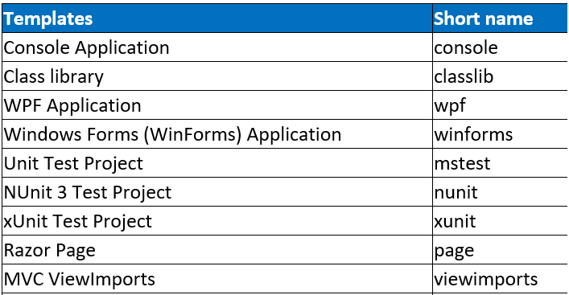
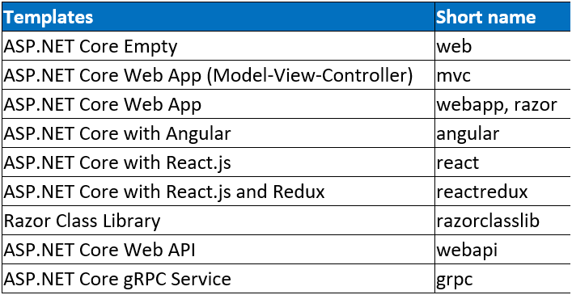
Introduction to dotnet CLI

Slide 30
Demo Create a C# Console App using dotnet CLI

Slide 31
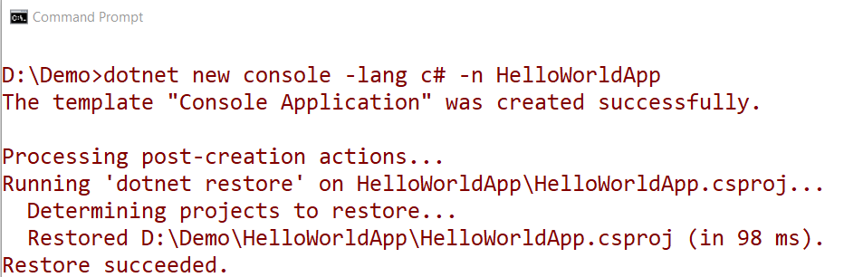
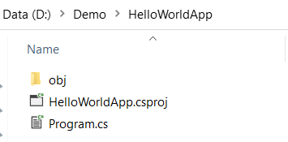
On Windows OS
Install package: dotnet-sdk-xxx.exe and open Command Prompt dialog
1. Create Console App named HelloWorldApp with C# language

Slide 32
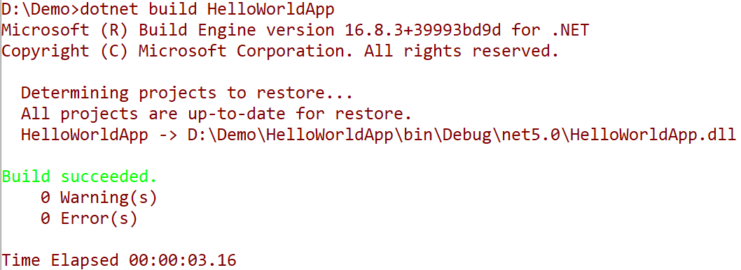
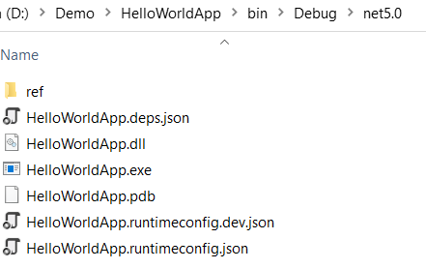
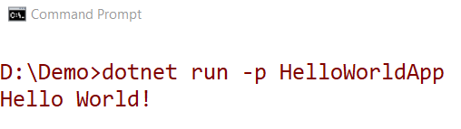
2. Build HelloWorldApp application
3. Run HelloWorldApp application

Slide 33
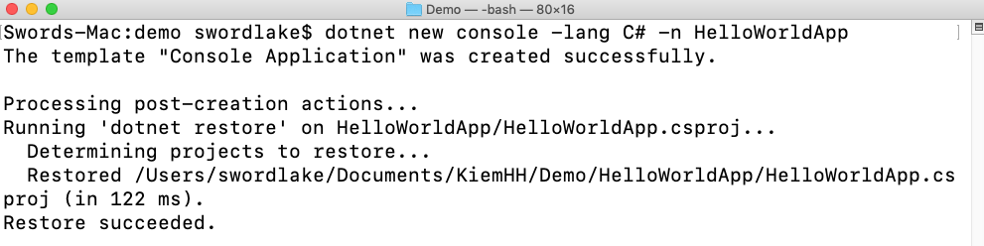
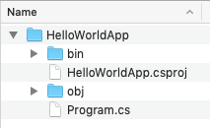

On macOS 10.14 "Mojave"
Install package: dotnet and open Terminal dialog
1. Create Console App named HelloWorldApp with C# language
2. Run HelloWorldApp application

Slide 34
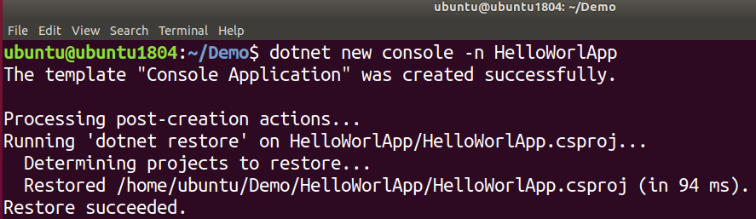
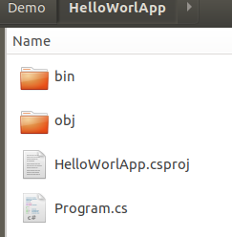

On Linux(Ubuntu 14.05) OS
Install package: dotnet and open Terminal dialog
1. Create Console App named HelloWorldApp with C# language
2. Run HelloWorldApp application

Slide 35
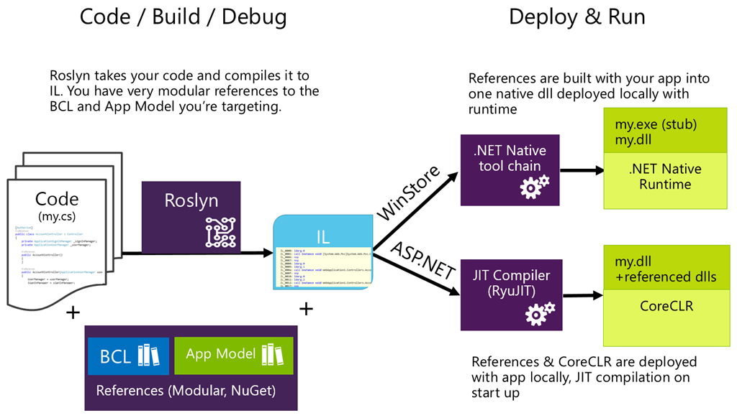
Compilation Process .NET Application

Slide 36
Compilation Process .NET Application
The compiler used by the dotnet CLI tool converts .NET source code(C#/VB/C++,..) into Intermediate Language (IL) code, and stores the IL in an assembly (a DLL or EXE file).
IL code statements are like assembly language instructions, but they are executed by .NET Core's virtual machine, known as the CoreCLR.
At runtime, the CoreCLR loads the IL code from the assembly, JIT compiles it into native CPU instructions, and then it is executed by the CPU on your machine.
The benefit of this two-step compilation process is that Microsoft can create CLRs for Linux and macOS as well as for Windows. The same IL code runs everywhere because of the second compilation process that generates code for the native operating system and CPU ...

Slide 37
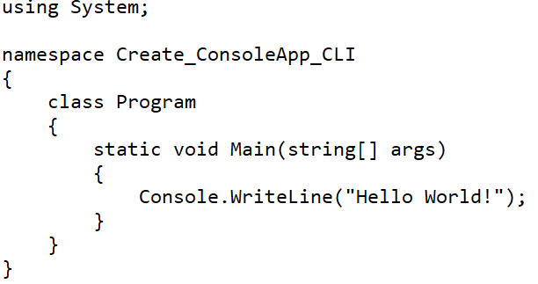
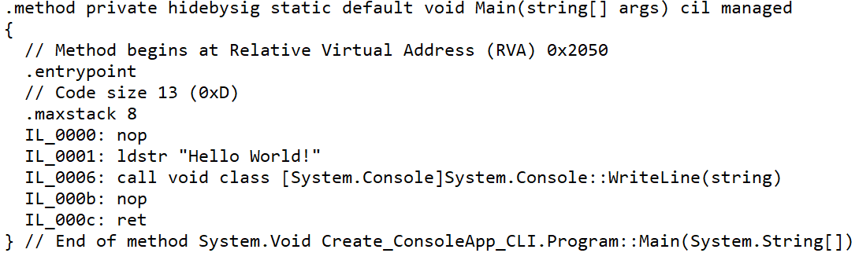
Common Intermediate Language (CIL)
CIL is a platform-neutral intermediate language (formerly called Microsoft Intermediate Language or MSIL) that represents the intermediate language binary instruction set defined by the CLI. It is a stack-based object-oriented assembly language that represents the code in byte-code format
C# source code
MSIL code
Notes:
To view MSIL of the assemblies :
1.Install ildasm tool : dotnet tool install -g dotnet-ildasm
2.View IL : dotnet ildasm Create_ConsoleApp_CLI.dll -o OutpuFileILCode.il

Slide 38
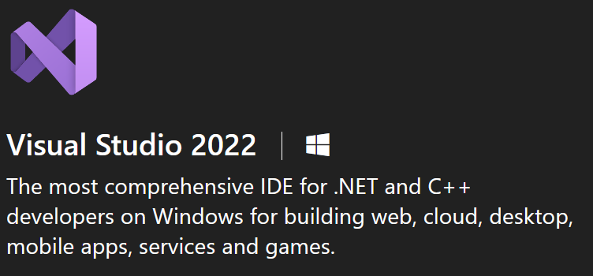
Introduction to Visual Studio.NET
Read by yourself
Visual Studio is one of the most famous IDE’s has been using for the last few years.
Microsoft developed it. It is used to create a computer program, web applications, and EXE files, etc.
The first version of its kind was launched in 1997.
And now the latest version available in the market is Visual Studio 2022.

Slide 39
Introduction to Visual Studio.NET
Read by yourself
New User Experienced Start Window: Check out the code, Open a project, Open a folder and Create a new project
Visual Studio Live Share: Live Share is a developer service in Visual Studio 2019. This feature directly enables to share code context and debugging process with your teammates and get live access within Visual Studio itself like Google document services.
Improved Refactoring: Refactoring in any IDE will highly helpful for developers. In Visual Studio 2019 these refactorings will come up with new advanced features, and these are used to organize your code in a structured manner.

Slide 40
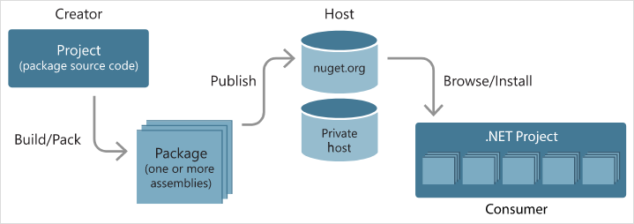
Introduction to Nuget packages
.NET is split into a set of packages, distributed using a Microsoft supported package management technology named NuGet. Each of these packages represents a single assembly of the same name.
For example, the System.Collections package contains the System.Collections.dll assembly.

Slide 41
Introduction to Nuget packages
Read by yourself
Install and use a package for .NET project in Visual Studio
Using NuGet Package Manager
(For Windows: https://docs.microsoft.com/en-us/nuget/quickstart/install-and-use-a-package-in-visual-studio )
(For Mac: https://docs.microsoft.com/en-us/nuget/quickstart/install-and-use-a-package-in-visual-studio-mac )
Using the dotnet CLI
(https://docs.microsoft.com/en-us/nuget/quickstart/install-and-use-a-package-using-the-dotnet-cli )

Slide 42
Summary
Concepts were introduced:
Overview about .NET Core
Overview .NET 5 Core Architecture
Overview new features of Visual Studio.NET
Explain about Cross-platform application with .NET
Why .NET Core and C# Language is selected as develop application?
Explain and demo using “dotnet CLI” to create C# Console App
Overview NuGet package
Create and Run cross-platform Console application with C#

